Slide 1
Rideshare Archival Record
Yoni Ben-Meshulam
Garrett Cooper
Derrick Huhn
Patrick Lowry
Notes:
yoni, name like this?

Slide 2
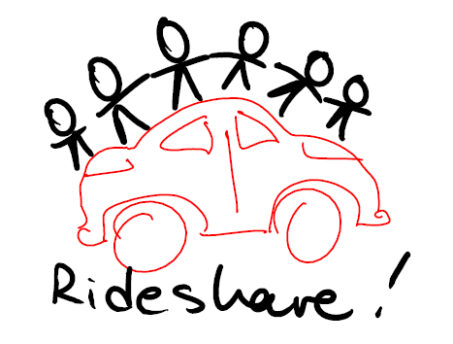
Outline
The Carpooling problem
How Rideshare solves it
Design choices
What is involved?
Optimizer
User Interface
Controller
How successful is it at solving the problem?
Testing
Evaluation
Project management - Trac

Slide 3
Problem Statement
Carpooling Problem = Vehicle Routing Problem
But Really:
Capacitated Multi-Depot Vehicle Routing Problem with Time-Windows
Other Preferences (age, gender, rating)
NP-Hard
Realistic solution times
Globally optimized
Reduce consumption, ecological footprint, cost, and energy dependency.

Slide 4
Choices
User Interface
Maps Integration
Google Maps, MapQuest, Yahoo! Maps
Optimization
Controller Library
Maps Integration
Database Interaction
Build System
Optimizers
Brute Force, Genetic, Bipartite Graph Matching

Slide 5
Architecture
Separated user interface from optimizers
Communicate information through database
Allows data to be gathered while optimizers are running
Rideshare Application
Users
User Interface
Controller
Optimizer
Rideshare Database

Slide 6
Optimizer Challenges
Framework to build on
Usable by all optimizers
Assessing Compatibility between a Rideshare and an unmatched rider
Simple preference checks
Scheduling
Deviation
Optimizing the order of points in a route
Common Scoring Function

Slide 7
Scoring Function
Allows us to compare different solutions
Users Matched (Whole Number)
The number of matched users (drivers and riders)
Bias toward spreading riders
Distance (Fraction)
Total distance all drivers will take (whether they are matched or not)
Minimizes route deviation
Notes:
Defines optimal solution as the most matched people going the shortest distance.
I can talk on this slide for at least a minute. obviously, the scoring function is crucial, but we need to make sure they know.

Slide 8
Bipartite Optimizer
1. Get seed solution
Such a path allows us to add one edge to the matching, since the number of unmatched edges is one greater than the number of matched edges.
5. Repeat 3-4 until all unmatched riders have been
tried.
This produces a maximal matching:
2. Connect compatible
riders and rideshares
with unmatched edges.
6. Add all matched riders to their rideshares.
7. Repeat 2-6, until no more augmenting paths exist.
a
a
Rideshares
Unmatched riders
c
b
c
b
Unmatched edges
Matched edges
The path a->b->c is an augmenting path. It allows us to remove b and add a and c to the matching.
4. Exchange all unmatched and matched edges on the augmenting path.
3. For each unmatched rider, check if there is an augmenting path leading from that rider.
Notes:
Please split up. Too much text

Slide 9

Brute Force Optimizer
1. Get seed Solution
2. For each solution in the space of all
possible solutions, compare it with the
best one so far.
Keep only the better of the two.
Notes:
Yoni hands it off to Patrick

Slide 10
Genetic Optimizer
1. Get seed solution
2. Spawn a generation of solutions from the seed, randomly matching ride offers and requests
4. Keep a copy of the
best solution
3. Keep a handful of the best solutions
6. Once the score
settles, return
the best solution
5. Spawn another generation from the last generation’s best solutions
(repeat until best
score settles)

Slide 11
Architecture (User Interface)
Rideshare Application
Users
User Interface
Controller
Optimizer
Rideshare Database

Slide 12
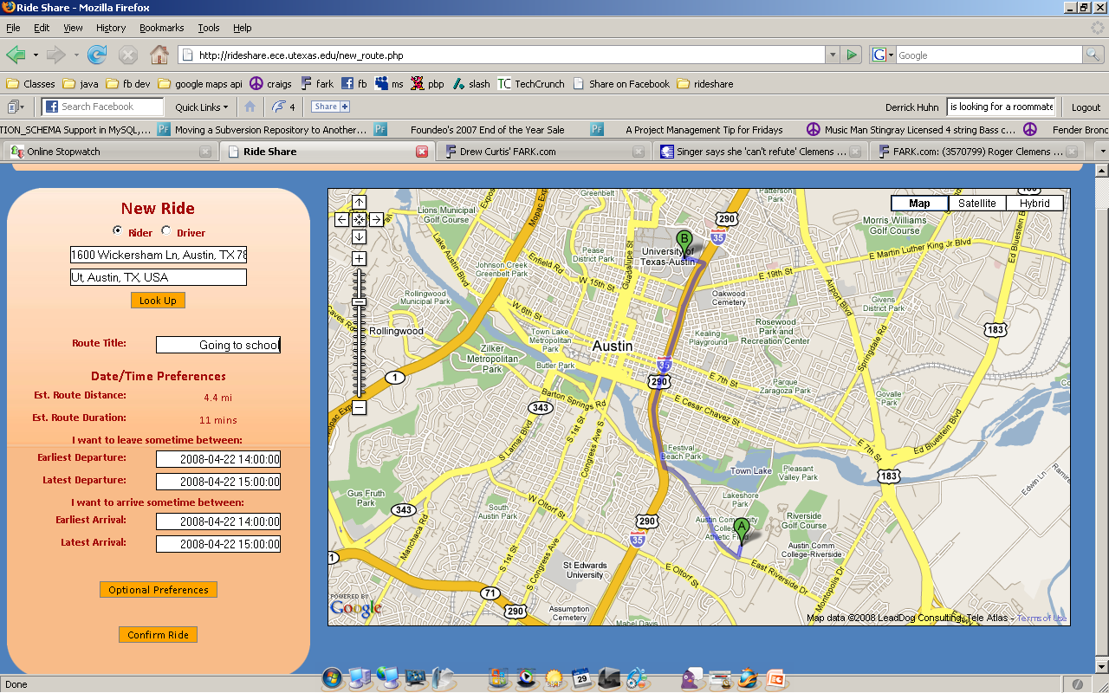
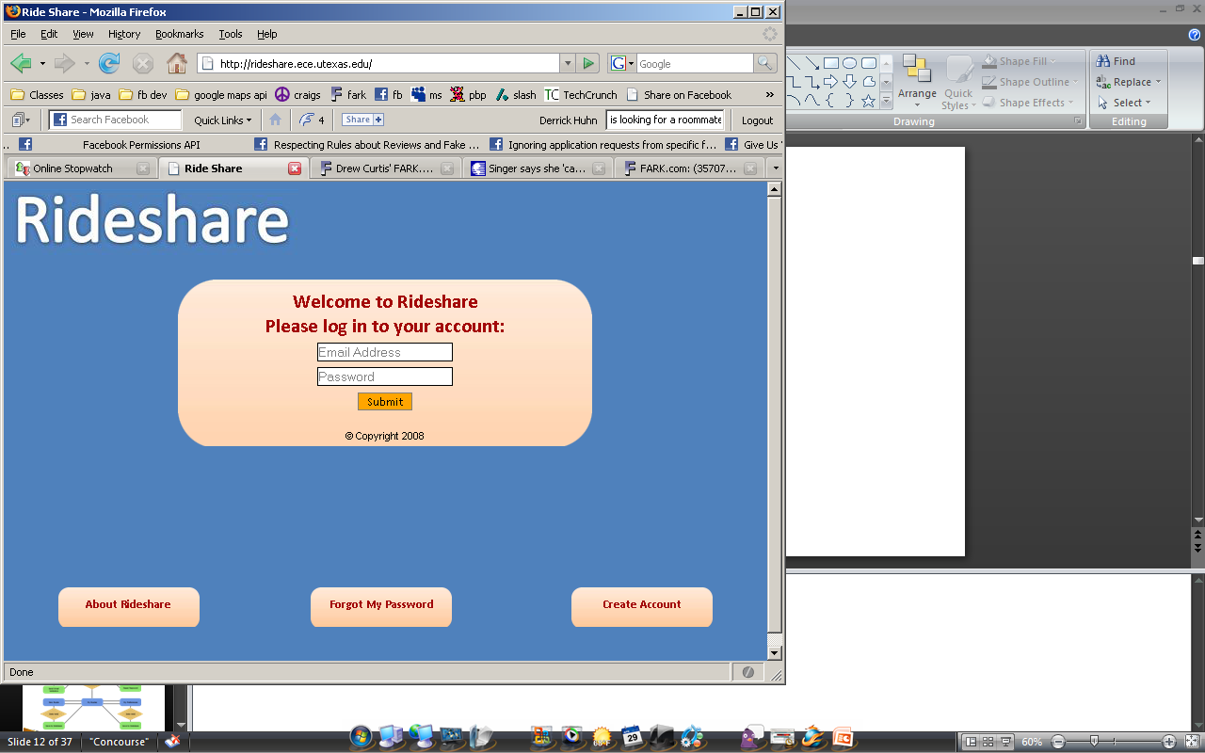
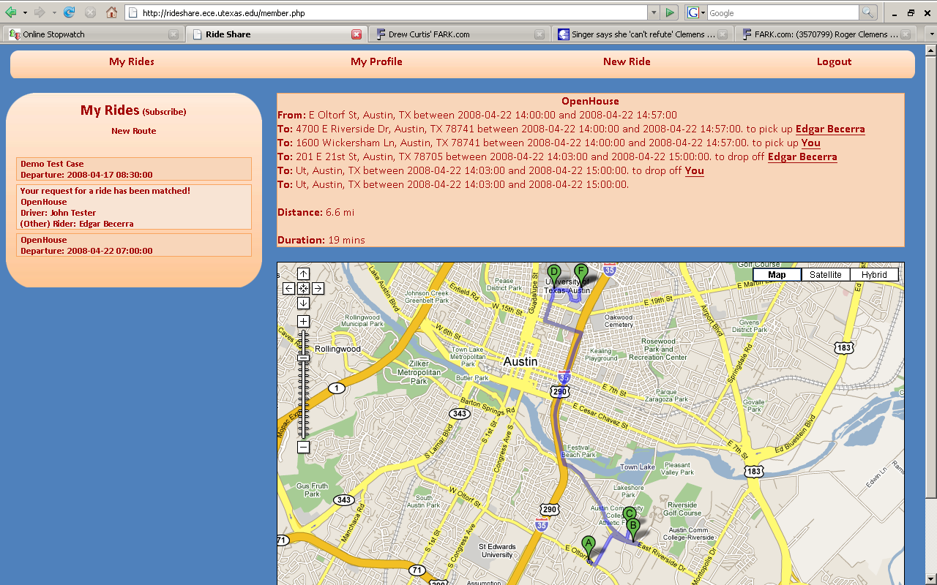
Screen shots

Slide 13
Front-End Challenges
Multiple Users
Extensible
Cascading StyleSheets (CSS)
Google Maps
Offload complex address translation
AJAX Problems
Input Data Handling
Analyze and Interpret Input Data
RSS Feeds
Notes:
Will revise later

Slide 14
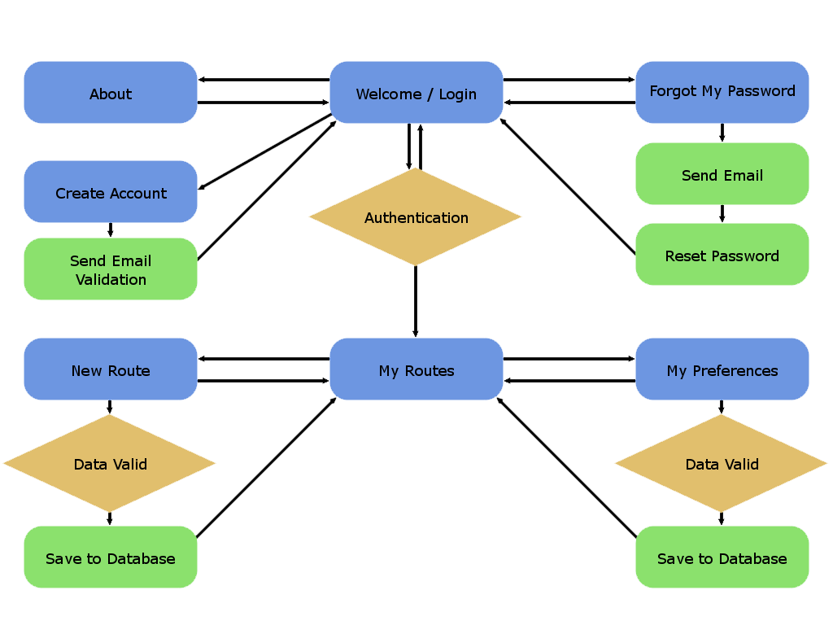
Front-End Map

Slide 15
Database Challenges
Data Formatting and Structure
Had to be usable for both the front and back-ends
DATETIME, and ENUM data types
Data Duplication
How to avoid it?
More tables
How to represent complex data structures?
Matches in solutions

Slide 16
Database Structure
Route_Submissions
Route_ID
User_ID
Title
Start_Address
Start_Loc_Lat
Start_Loc_Long
Leave_Time_Earliest
Leave_Time_Latest
End_Address
End_Loc_Lat
End_Loc_Long
Arrive_Time_Earliest
Arrive_Time_Latest
Optimal_Route_Length
Optimal_Route_Time
Driver_Or_Rider
Comment
Match_ID
Solution_ID
Solutions
Solution_ID
Optimizer
Calculated
Matches
Solution_ID
Match_ID
Route_ID
Sequence_Num
Earliest
Latest
Users
User_ID
First_Name
Last_Name
Email_Addr
Password_Hash
Gender_ID
Age
RSS_URL
RSA_N
RSA_D
RSA_E
Route_Preferences
Route_ID
Age_Min
Age_Max
Gender_ID
User_Preferences
User_ID
Age_Min
Age_Max
Gender_ID
Users_Pending_Validation
Validation_Key
Key_Sent_Date
First_Name
Last_Name
Email_Addr
Password_Hash
Route_Driver_Options
Route_ID
Capacity

Slide 17
Architecture (Controller)
Rideshare Application
Users
User Interface
Controller
Optimizer
Rideshare Database
Notes:
Patrick hands it off to Derrick

Slide 18
Controller Challenges
Database communication
MySQL++ Library
Limitations of Libraries (MapQuest API)
RouteMatrix only supported 25 Locations
Solution: RouteMatrixLocal – Local route calculations
Data structures
STL: Vectors -> Maps
Represent Driver and Rider Submissions, Matches, Solutions, etc.
Remote Development

Slide 19
Controller Implementation
Executable for invoking libController’s features
Components
libController
Optimizer Logic
Database Access
Data structures for optimizer
Algorithm Visualizer
Notifications

Slide 20
libController
8,000+ Lines of Code
45 C++ Files
Optimizer Logic - 13 Files
Database Access – 4 Files
Data structures – 17 Files
Utility – 11 Files
Build System
MySQL++ and MapQuest Advantage API

Slide 21
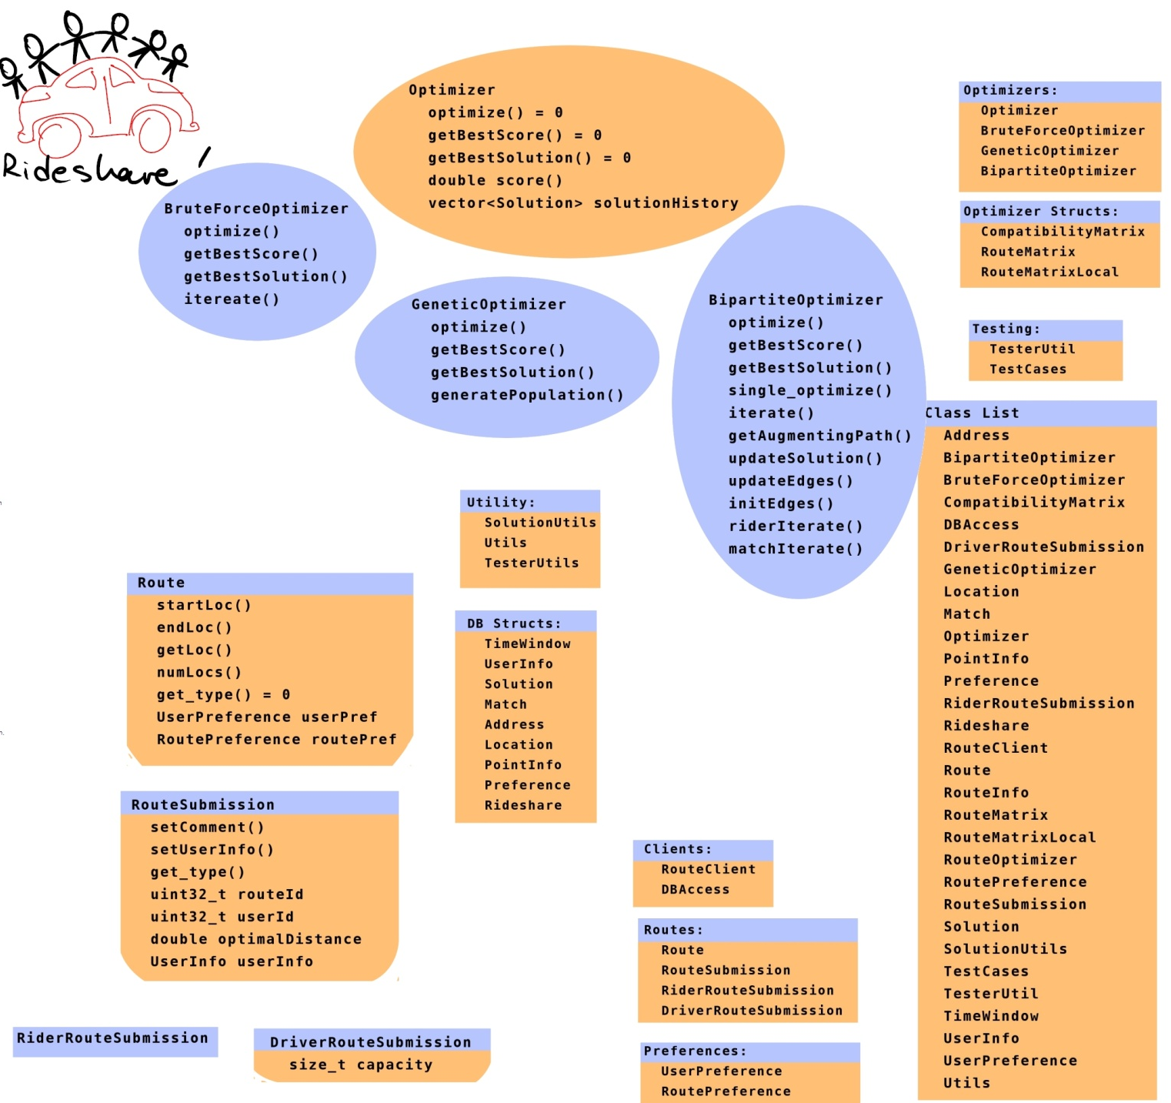
Class List
Notes:
I don’t know what we want to do with this..

Slide 22
Algorithm Visualizer
Visual display of intermediate solutions generated by optimizers
XHTML/JavaScript
Animation utilizes MapQuest’s image API
Metaprogramming
C++ generates JavaScript that is executed in browser

Slide 23
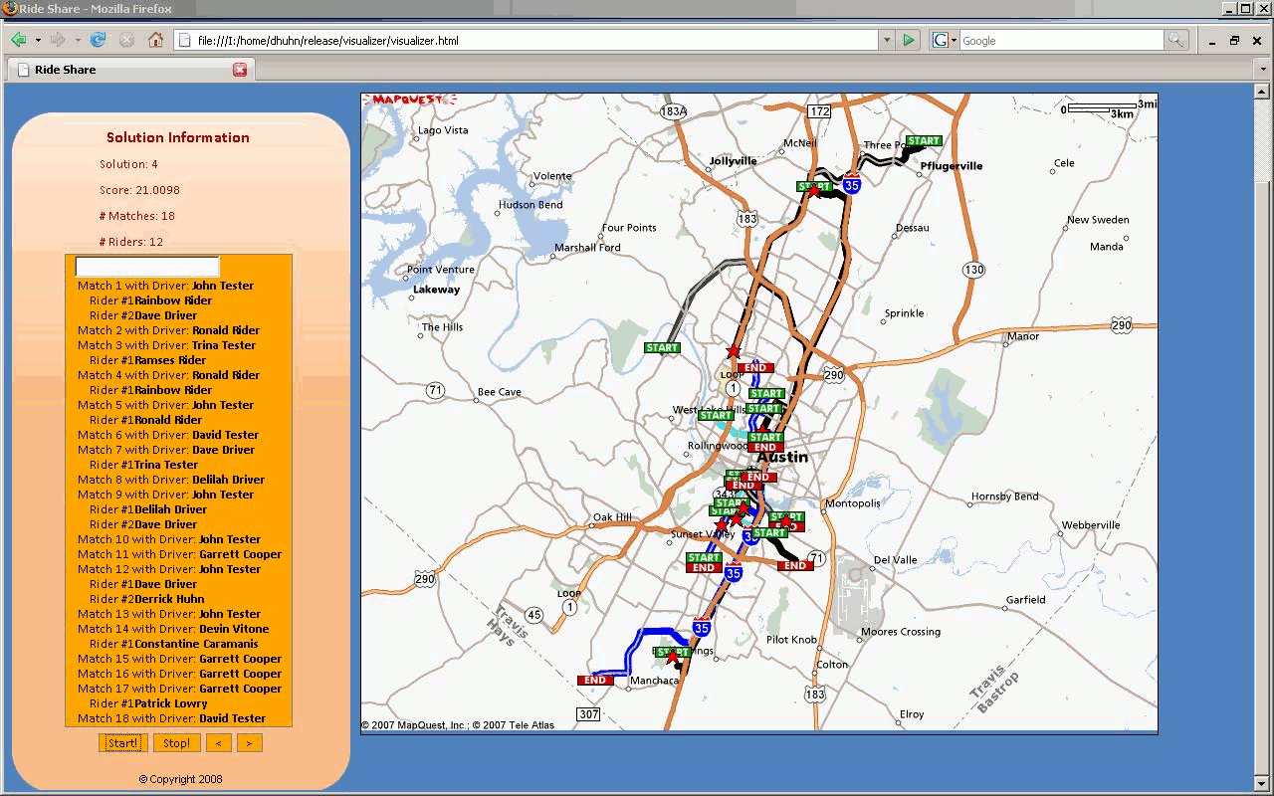

Slide 24
Notifications (E-mail and RSS Feed)
E-mail
Users need to be notified when they have been matched in a Rideshare
C++ Generates Perl which invokes SendMail
Use libController to retrieve users’ emails
RSS Feed
Users can subscribe to an RSS feed that is dynamically generated using PHP
Real-time notification for active users

Slide 25

Testing and Optimizer Evaluation
Unit Tests
uShip Data
Corner Cases
Optimizer Characterization and Evaluation
Notes:
Derrick hands it off to Garrett
this is kind of a roadmap slide, because testing is a big part of the final report. each of the categories here have their own subheadings that should be more than one slide
unit tests per module
optimizer test cases (garrett’s corner cases)
characterization – yoni’s graphs
clipart is kind of a placeholder, the slide felt empty

Slide 26
Unit Tests
Over 100 individual unit tests
Each feature/function tested individually
Hand-tailored test cases
Used for stabilization before each commit

Slide 27
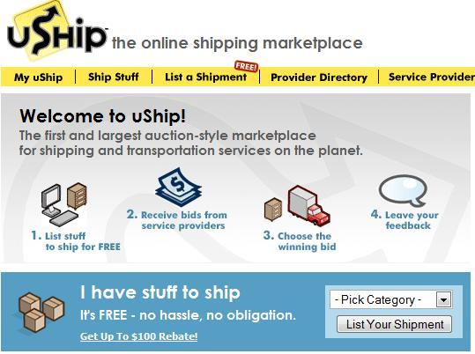
uShip Data
Raw uShip Data
2100 Working Locations in Texas
uShip Data with Preferences
20 Non-inclusive test cases
Size ranges from 7 to 120, with regular increments
data and screenshot thanks to uShip.com
Notes:
Add numbers to this

Slide 28
Corner Cases
Designed to test specific functions of the optimizers
Capacity
Going Out of the Way
Moving backwards to pick up a rider
Picking up the closer rider
Time Windows
Maximum Route Deviation
Maximizing Riders
Single-solution test case for Bipartite

Slide 29
Notes:
Clearly, the genetic optimizer is producing higher scores (everywhere except 2nd test case).
Seems as though the Bipartite is improving, since the ratio of BP/G is increasing.

Slide 30
Notes:
Regular Time:
No clear advantage to either.
Bipartite is being run 8 times, so it is a lot faster, really.
At the upper end, we see two things:
Doesn’t keep growing as fast. Need to try larger test cases to confirm where it’s going.
Unpredictable behavior, suggests the time is correlated not only to the number of users, but to the optimal score. Next slide goes into this.
Possible reason for both observations: data is not inclusive of previous test case. If it was, it is likely that the dips would go away.
Log:
We see an exponential increase at the lower end (straight line = exponential).
The growth looks like it’s levelling off, meaning we definitely don’t have exponential growth. We do, however need to confirm this, again by using larger test cases, and using cases that are inclusive of one another.

Slide 31
Run Time vs. Final Score
Notes:
Motivation:
Previous graphs suggested that the time is correlated to something other than the number of users.
These graphs show the correlation with the final score.
If each point was the absolute optimal one, we would expect to see a linear curve.
Reason there might be a correlation: higher score means more expensive compatibility checking.
Genetic:
We observe that it looks just like a linear curve, so it looks like it’s finding a very large part of the optimal matchings.
No visible correlation between time and score
Bipartite:
Visible correlation between time and score (look at the dips)

Slide 32
Time and Cost Considerations
Cost
Open Source == Free
ECE Department provided Development Systems
Time
Coupled tasks that hindered development
15% debugging C++ related problems
5% dedicated to code not used
20% dedicated to user interface
Improvements
20% of tickets involved fixing bugs
More code review sessions!

Slide 33
Safety and Ethical Aspects
Personal safety:
Encourage users to take advantage of site features to screen matches
Minimum age eighteen
Social Innovation
Reduce ecological footprint
Save time and energy
Promote cooperative, sustainable living

Slide 34
Trac
Wiki System
Ticket System
Subversion Integration
Timeline/Roadmap

Slide 35
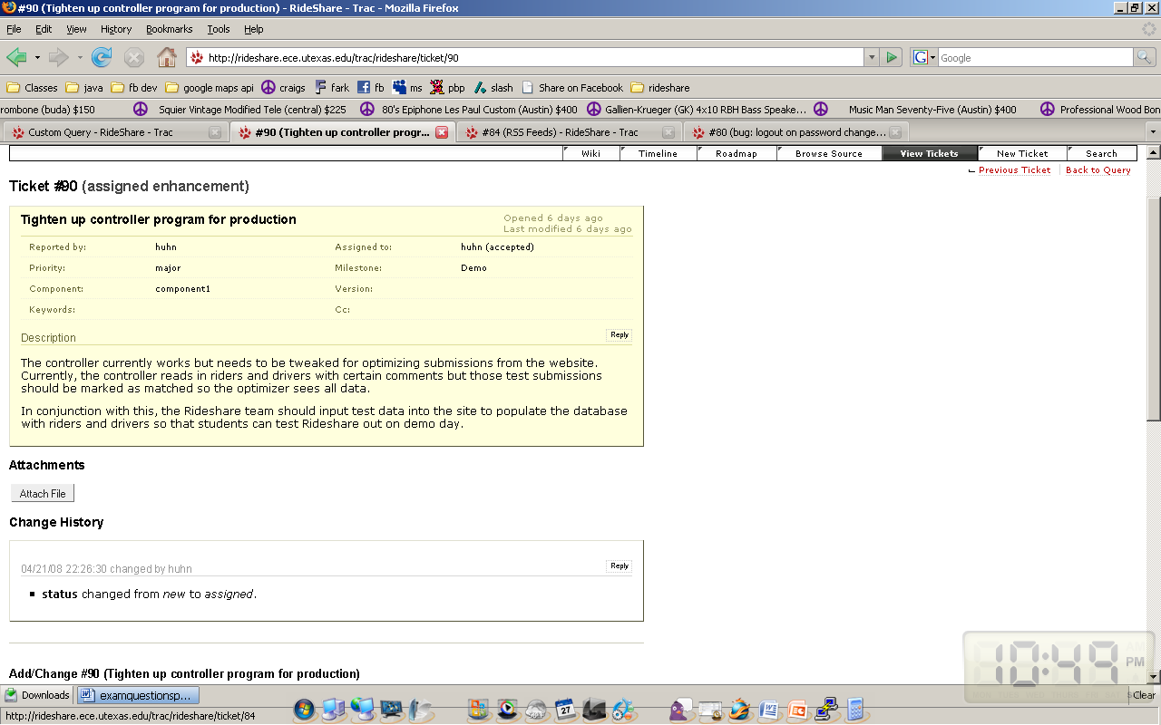
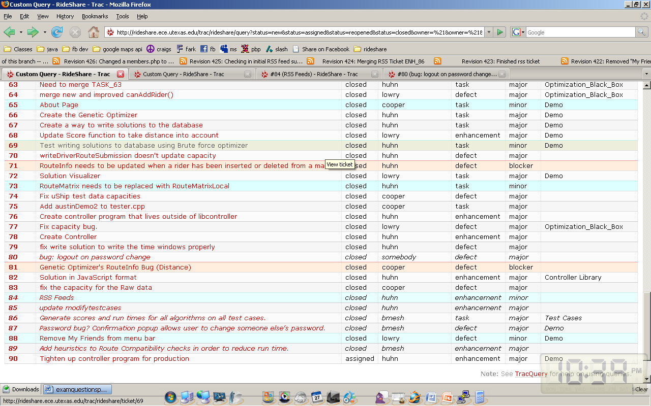
Ticket System

Slide 36
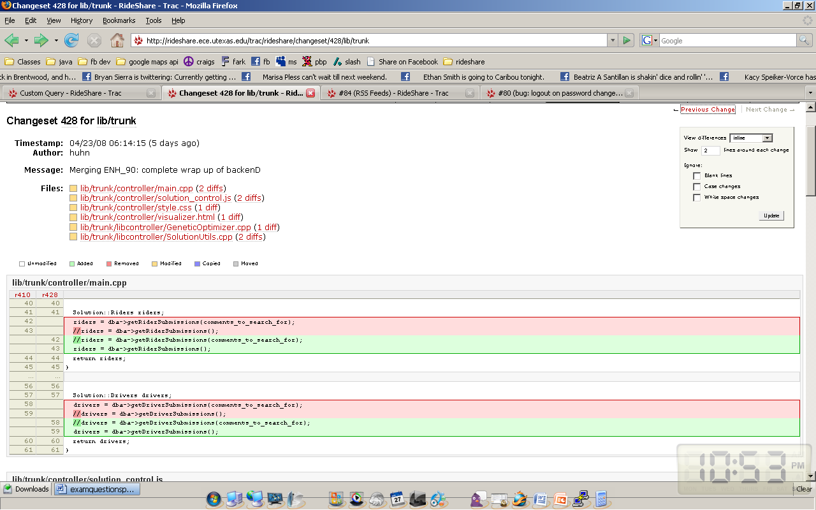
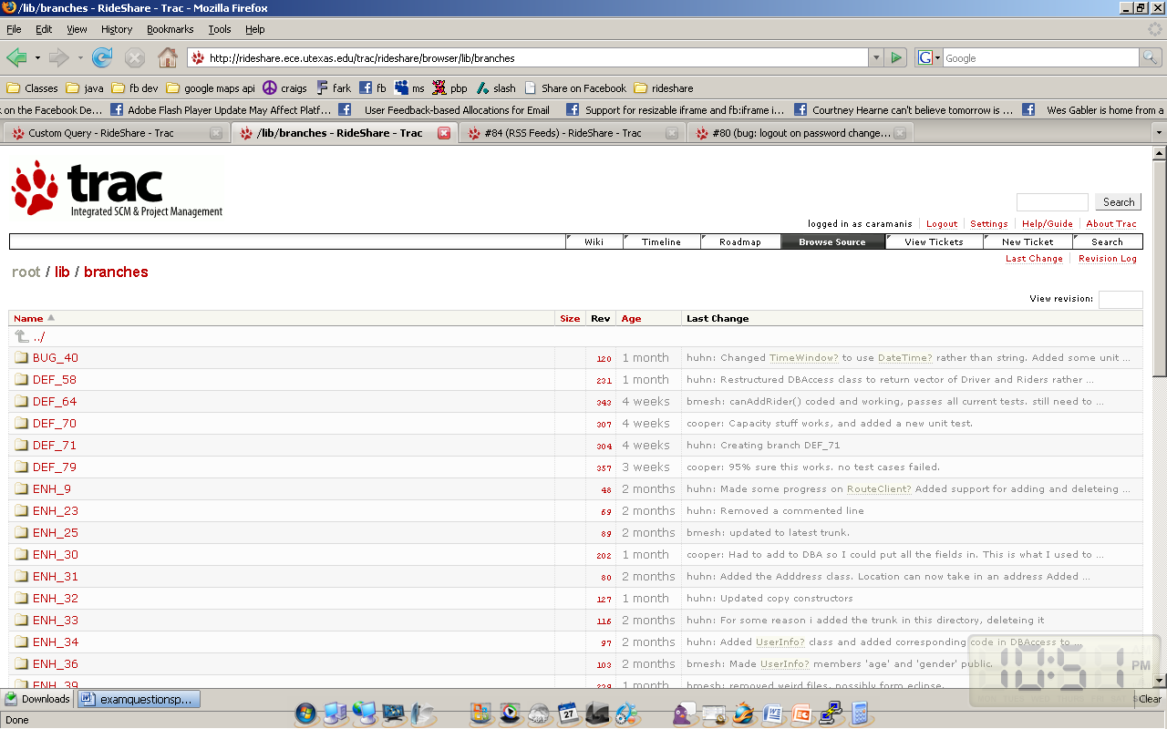
Subversion Integration

Slide 37
Conclusions and Recommendations
Results
Completed all of the tasks for optimization
Didn’t implement problem reduction (not a necessity)
Didn’t implement confirmation (time)
Successful testing of all functionalities
Recommendations
Develop user interface for social networking, phones
Extensible Design

